Slide 1
Artificial Intelligence Uncertainty
Notes:
1

Slide 2
Acting under uncertainty
Almost never the epistemological commitment that propositions are true or false can be made.
In practice, programs have to act under uncertainty:
using a simple but incorrect theory of the world, which does not take into account uncertainty and will work most of the time
handling uncertain knowledge and utility (tradeoff between accuracy and usefulness) in a rational way
The right thing to do (the rational decision) depends on:
the relative importance of various goals
the likelihood that, and degree to which, they will be achieved
Notes:
2

Slide 3
Handling uncertain knowledge
Example of rule for dental diagnosis using first-order logic:
∀p Symptom(p, Toothache) ⇒ Disease(p, Cavity)
This rule is wrong and in order to make it true we have to add an almost unlimited list of possible causes:
∀p Symptom(p, Toothache) ⇒ Disease(p, Cavity) ∨ Disease(p, GumDisease) ∨ Disease(p, Abscess)…
Trying to use first-order logic to cope with a domain like medical diagnosis fails for three main reasons:
Laziness. It is too much work to list the complete set of antecedents or consequents needed to ensure an exceptionless rule and too hard to use such rules.
Theoretical ignorance. Medical science has no complete theory for the domain.
Practical ignorance. Even if we know all the rules, we might be uncertain about a particular patient because not all the necessary tests have been or can be run.
Notes:
3

Slide 4
Handling uncertain knowledge
Actually, the connection between toothaches and cavities is just not a logical consequence in any direction.
In judgmental domains (medical, law, design...) the agent’s knowledge can at best provide a degree of belief in the relevant sentences.
The main tool for dealing with degrees of belief is probability theory, which assigns to each sentence a numerical degree of belief between 0 and 1.
Notes:
4

Slide 5
Handling uncertain knowledge
Probability provides a way of summarizing the uncertainty that comes from our laziness and ignorance.
Probability theory makes the same ontological commitment as logic:
facts either do or do not hold in the world
Degree of truth, as opposed to degree of belief, is the subject of fuzzy logic.
Notes:
5

Slide 6
Handling uncertain knowledge
The belief could be derived from:
statistical data
80% of the toothache patients have had cavities
some general rules
some combination of evidence sources
Assigning a probability of 0 to a given sentence corresponds to an unequivocal belief that the sentence is false.
Assigning a probability of 1 corresponds to an unequivocal belief that the sentence is true.
Probabilities between 0 and 1 correspond to intermediate degrees of belief in the truth of the sentence.
Notes:
6

Slide 7
Handling uncertain knowledge
The sentence itself is in fact either true or false.
A degree of belief is different from a degree of truth.
A probability of 0.8 does not mean “80% true”, but rather an 80% degree of belief that something is true.
Notes:
7

Slide 8
Handling uncertain knowledge
In logic, a sentence such as “The patient has a cavity” is true or false.
In probability theory, a sentence such as “The probability that the patient has a cavity is 0.8” is about the agent’s belief, not directly about the world.
These beliefs depend on the percepts that the agent has received to date.
These percepts constitute the evidence on which probability assertions are based
For example:
An agent draws a card from a shuffled pack.
Before looking at the card, the agent might assign a probability of 1/52 to its being the ace of spades.
After looking at the card, an appropriate probability for the same proposition would be 0 or 1.
Notes:
8

Slide 9
Handling uncertain knowledge
An assignment of probability to a proposition is analogous to saying whether a given logical sentence is entailed by the knowledge base, rather than whether or not it is true.
Before evidence is obtained prior or unconditional probability.
After evidence is obtained posterior or conditional probability.
Notes:
9

Slide 10
Basic probability notation
Propositions
Degrees of belief are always applied to propositions, assertions that such-and-such is the case.
The basic element of the language used in probability theory is the random variable, which can be thought of as referring to a “part” of the world whose “status” is initially unknown.
For example, Cavity might refer to whether my lower left wisdom tooth has a cavity.
Each random variable has a domain of values that it can take on.
Notes:
10

Slide 11
Propositions
As with CSP variables, random variables (RVs) are typically divided into three kinds, depending on the type of the domain:
Boolean RVs, such as Cavity, have the domain <true, false>.
Discrete RVs, which include Boolean RVs as a special case, take on values from a countable domain.
Continuous RVs take on values from the real numbers.
Notes:
11

Slide 12
Atomic events
An atomic event (or sample point) is a complete specification of the state of the world.
It is an assignment of particular values to all the variables of which the world is composed.
Example:
If the world consists of only the Boolean variables Cavity and Toothache, then there are just four distinct atomic events.
The proposition Cavity = false ∧ Toothache = true is one such event.
Notes:
12

Slide 13
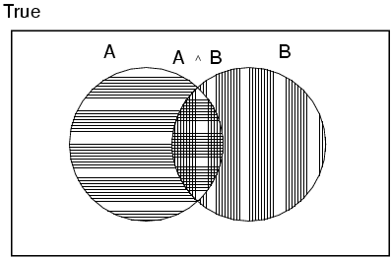
Axioms of probability
For any propositions a, b
0 ≤ P(a) ≤ 1
P(true) = 1 and P(false) = 0
P(a ∨ b) = P(a) + P(b) - P(a ∧ b)
Notes:
13

Slide 14
Prior probability
The unconditional or prior probability associated with a proposition a is the degree of belief accorded to it in the absence of any other information.
It is written as P(a).
Example:
P(Cavity = true) = 0.1 or P(cavity) = 0.1
It is important to remember that P(a) can be used only when there is no other information.
To talk about the probabilities of all the possible values of a RV:
expressions such as P(Weather) are used, denoting a vector of values for the probabilities of each individual state of the weather
Notes:
14

Slide 15
Prior probability
P(Weather) = <0.7, 0.2, 0.08, 0.02> (normalized, i.e., sums to 1)
(Weather‘s domain is <sunny, rain, cloudy, snow>)
This statement defines a prior probability distribution for the random variable Weather.
Expressions such as P(Weather, Cavity) are used to denote the probabilities of all combinations of the values of a set of RVs.
This is called the joint probability distribution of Weather and Cavity.
Notes:
15

Slide 16
Prior probability
Joint probability distribution for a set of random variables gives the probability of every atomic event with those random variables.
P(Weather,Cavity) = a 4 × 2 matrix of probability values:
Every question about a domain can be answered by the joint distribution.
Weather =
sunny
rainy
cloudy
snow
Cavity = true
0.144
0.02
0.016
0.02
Cavity = false
0.576
0.08
0.064
0.08
Notes:
16

Slide 17
Conditional probability
Conditional or posterior probabilities:
e.g., P(cavity | toothache) = 0.8
i.e., given that toothache is all I know
Notation for conditional distributions:
P(Cavity | Toothache) = 2-element vector of 2-element vectors
If we know more, e.g., cavity is also given, then we have
P(cavity | toothache, cavity) = 1 (trivial)
New evidence may be irrelevant, allowing simplification, e.g.,
P(cavity | toothache, sunny) = P(cavity | toothache) = 0.8
This kind of inference, sanctioned by domain knowledge, is crucial.
Notes:
17

Slide 18
Conditional probability
Definition of conditional probability:
P(a | b) = P(a ∧ b) / P(b) if P(b) > 0
Product rule gives an alternative formulation:
P(a ∧ b) = P(a | b) P(b) = P(b | a) P(a)
A general version holds for whole distributions, e.g.,
P(Weather,Cavity) = P(Weather | Cavity) P(Cavity)
(View as a set of 4 × 2 equations, not matrix multiplication)
Chain rule is derived by successive application of product rule:
P(X₁, …,X_{n}) = P(X₁,...,X_{n-1}) P(X_{n} | X₁,...,X_{n-1})
= P(X₁,...,X_{n-2}) P(X_{n-1} | X₁,...,X_{n-2}) P(X_{n} | X₁,...,X_{n-1})
= …
= π_{i= 1}^{n} P(X_{i} | X₁, … ,X_{i-1})
Notes:
18

Slide 19

Inference by enumeration
A simple method for probabilistic inference uses observed evidence for computation of posterior probabilities.
Start with the joint probability distribution:
For any proposition φ, sum the atomic events where it is true: P(φ) = Σ_{ω:ω╞φ} P(ω)
Notes:
19

Slide 20

Inference by enumeration
Start with the joint probability distribution:
For any proposition φ, sum the atomic events where it is true: P(φ) = Σ_{ω:ω╞φ} P(ω)
P(toothache) = 0.108 + 0.012 + 0.016 + 0.064 = 0.2
Notes:
20

Slide 21

Inference by enumeration
Start with the joint probability distribution:
For any proposition φ, sum the atomic events where it is true: P(φ) = Σ_{ω:ω╞φ} P(ω)
P(toothache ∨ cavity) = 0.108 + 0.012 + 0.016 + 0.064 + 0.072 + 0.008 = 0.28
Notes:
21

Slide 22

Inference by enumeration
Start with the joint probability distribution:
Conditional probabilities:
P(¬cavity | toothache) = P(¬cavity ∧ toothache)
P(toothache)
= 0.016+0.064
0.108 + 0.012 + 0.016 + 0.064
= 0.4
P(a | b) = P(a ∧ b) / P(b) if P(b) > 0
Notes:
22

Slide 23
Marginalization
One particularly common task is to extract the distribution over some subset of variables or a single variable.
For example, adding the entries in the first row gives the unconditional probability of cavity:
P(cavity) = 0.108+0.012+0.072+0.008 = 0.2
23
23
Notes:
23

Slide 24
Marginalization
This process is called marginalization or summing out, because the variables other than Cavity are summed out.
General marginalization rule for any sets of variables Y and Z:
P(Y) = Σ_{z}P(Y, z)
A distribution over Y can be obtained by summing out all the other variables from any joint distribution containing Y.
24
24
Notes:
24

Slide 25
Marginalization
Typically, we are interested in:
the posterior joint distribution of the query variables X
given specific values e for the evidence variables E.
Let the hidden variables be Y.
Then the required summation of joint entries is done by summing out the hidden variables:
P(X | E = e) = P(X,E = e) / P(e) = Σ_{y} P(X,E = e, Y = y) / P(e)
X, E and Y together exhaust the set of random variables.
Notes:
25

Slide 26
Normalization
P(cavity | toothache) = P(cavity ∧ toothache) =
P(toothache)
= 0.108+0.012
0.108 + 0.012 + 0.016 + 0.064
P(¬cavity | toothache) = P(¬cavity ∧ toothache) =
P(toothache)
= 0.016+0.064
0.108 + 0.012 + 0.016 + 0.064
Notice that in these two calculations the term 1/P(toothache) remains constant, no matter which value of Cavity we calculate.
26
26
Notes:
26

Slide 27
Normalization
The denominator can be viewed as a normalization constant α for the distribution P(Cavity | toothache), ensuring it adds up to 1.
With this notation and using marginalization, we can write the two preceding equations in one:
P(Cavity | toothache) = α P(Cavity,toothache)
= α [P(Cavity,toothache,catch) + P(Cavity,toothache,¬ catch)]
= α [<0.108,0.016> + <0.012,0.064>]
= α <0.12,0.08> = <0.6,0.4>
27
27
Notes:
27

Slide 28
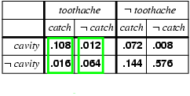
Normalization
P(Cavity | toothache) = α P(Cavity,toothache)
= α [P(Cavity,toothache,catch) + P(Cavity,toothache,¬ catch)]
= α [<0.108,0.016> + <0.012,0.064>]
= α <0.12,0.08> = <0.6,0.4>
General idea: compute distribution on query variable by fixing evidence variables and summing over hidden variables
Notes:
28

Slide 29
Inference by enumeration
Obvious problems:
Worst-case time complexity: O(d^{n}) where d is the largest arity and n is the number of variables
Space complexity: O(d^{n}) to store the joint distribution
How to define the probabilities for O(d^{n}) entries, when variables can be hundreds or thousand?
It quickly becomes completely impractical to define the vast number of probabilities required.
Notes:
29

Slide 30
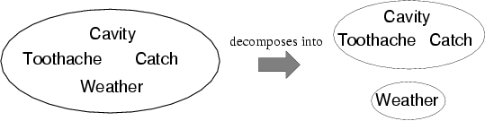
Independence
A and B are independent iff
P(A|B) = P(A) or P(B|A) = P(B) or P(A, B) = P(A) P(B)
P(Toothache, Catch, Cavity, Weather)
= P(Toothache, Catch, Cavity) P(Weather)
32 entries reduced to 12
For n independent biased coins, O(2^{n}) →O(n)
Absolute independence powerful but rare
Dentistry is a large field with hundreds of variables, none of which are independent. What to do?
Notes:
30

Slide 31
Conditional independence
P(Toothache, Cavity, Catch) has 2³ – 1 (because the numbers must sum to 1) = 7 independent entries
If I have a cavity, the probability that the probe catches in it doesn't depend on whether I have a toothache:
P(catch | toothache, cavity) = P(catch | cavity)
The same independence holds if I haven't got a cavity:
P(catch | toothache,¬cavity) = P(catch | ¬cavity)
Catch is conditionally independent of Toothache given Cavity:
P(Catch | Toothache,Cavity) = P(Catch | Cavity)
Equivalent statements:
P(Toothache | Catch, Cavity) = P(Toothache | Cavity)
P(Toothache, Catch | Cavity) = P(Toothache | Cavity) P(Catch | Cavity)
Notes:
31

Slide 32
Conditional independence
Full joint distribution using product rule:
P(Toothache, Catch, Cavity)
= P(Toothache | Catch, Cavity) P(Catch, Cavity)
= P(Toothache | Catch, Cavity) P(Catch | Cavity) P(Cavity)
= P(Toothache | Cavity) P(Catch | Cavity) P(Cavity)
The resultant three smaller tables contain 5 independent entries (2*(2¹-1) for each conditional probability distribution and 2¹-1 for the prior on Cavity)
In most cases, the use of conditional independence reduces the size of the representation of the joint distribution from exponential in n to linear in n.
Conditional independence is our most basic and robust form of knowledge about uncertain environments.
Notes:
32

Slide 33
Bayes' rule
Product rule
P(a∧b) = P(a | b) P(b)
P(a∧b) = P(b | a) P(a)
⇒ Bayes' rule:
P(a | b) = P(b | a) P(a) / P(b)
or in distribution form
P(Y|X) = P(X|Y) P(Y) / P(X) = αP(X|Y) P(Y)
Useful for assessing diagnostic probability from causal probability:
P(Cause|Effect) = P(Effect|Cause) P(Cause) / P(Effect)
Notes:
33

Slide 34
Bayes' rule: example
Here's a story problem about a situation that doctors often encounter:
1% of women at age forty who participate in routine screening have breast cancer. 80% of women with breast cancer will get positive mammographies. 9.6% of women without breast cancer will also get positive mammographies. A woman in this age group had a positive mammography in a routine screening. What is the probability that she actually has breast cancer?
What do you think the answer is?
34
Notes:
34

Slide 35
Bayes' rule: example
Most doctors get the same wrong answer on this problem - usually, only around 15% of doctors get it right. ("Really? 15%? Is that a real number, or an urban legend based on an Internet poll?" It's a real number. See Casscells, Schoenberger, and Grayboys 1978; Eddy 1982; Gigerenzer and Hoffrage 1995. It's a surprising result which is easy to replicate, so it's been extensively replicated.)
On the story problem above, most doctors estimate the probability to be between 70% and 80%, which is wildly incorrect.
35
Notes:
35

Slide 36
Bayes' rule: example
C = breast cancer (having, not having)
M = mammographies (positive, negative)
P(C) = <0.01, 0.99>
P(m | c) = 0.8
P(m | ¬c) = 0.096
1% of women at age forty who participate in routine screening have breast cancer. 80% of women with breast cancer will get positive mammographies. 9.6% of women without breast cancer will also get positive mammographies.
36
Notes:
36

Slide 37
Bayes' rule: example
Given
P(C) = <0.01, 0.99>
P(m | c) = 0.8
P(m | ¬c) = 0.096
P(c| m) = P(m | c) P(c) / P(m)
= α P(m | c) P(c)
= α <P(m | c) P(c), P(m | ¬c) P(¬c)> (probability of having cancer and not having cancer adds upto 1)
= α <0.8 * 0.01, 0.096 * 0.99>
= α <0.008, 0.095> = <0.078, 0.922>
P(c | m) = 7.8%
A woman in this age group had a positive mammography in a routine screening.
What is the probability that she has breast cancer?
37
Notes:
37

Slide 38
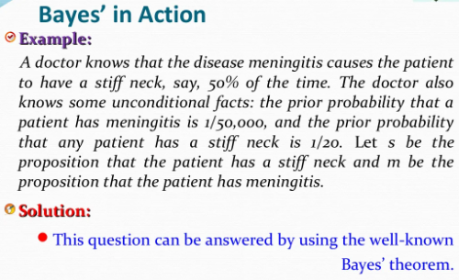
38

Slide 39
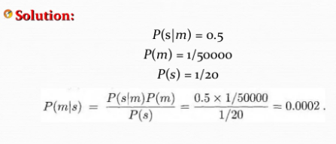
39

Slide 40
Bayes' Rule and conditional independence
P(Cavity | toothache ∧ catch)
= αP(toothache ∧ catch | Cavity) P(Cavity)
= αP(toothache | Cavity) P(catch | Cavity) P(Cavity)
The information requirements are the same as for inference using each piece of evidence separately:
the prior probability P(Cavity) for the query variable
the conditional probability of each effect, given its cause
Notes:
40

Slide 41
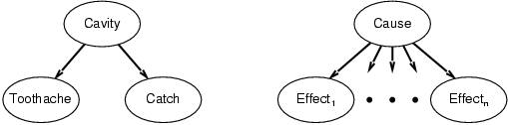
Naive Bayes
P(Cavity, Toothache, Catch) = P(Toothache, Catch, Cavity)
= P(Toothache | Catch, Cavity) P(Catch, Cavity)
= P(Toothache | Catch, Cavity) P(Catch | Cavity) P(Cavity)
= P(Toothache | Cavity) P(Catch | Cavity) P(Cavity)
This is an example of a naïve Bayes model:
P(Cause,Effect₁, … ,Effect_{n}) = P(Cause) π_{i}P(Effect_{i}|Cause)
Total number of parameters (the size of the representation) is linear in n.
Notes:
41

Slide 42
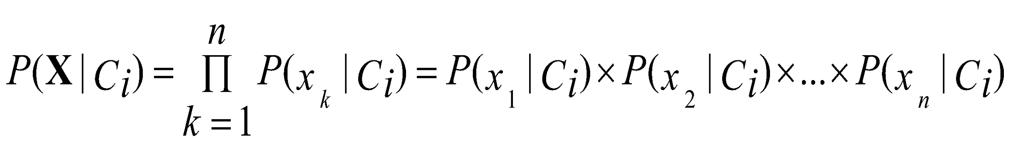
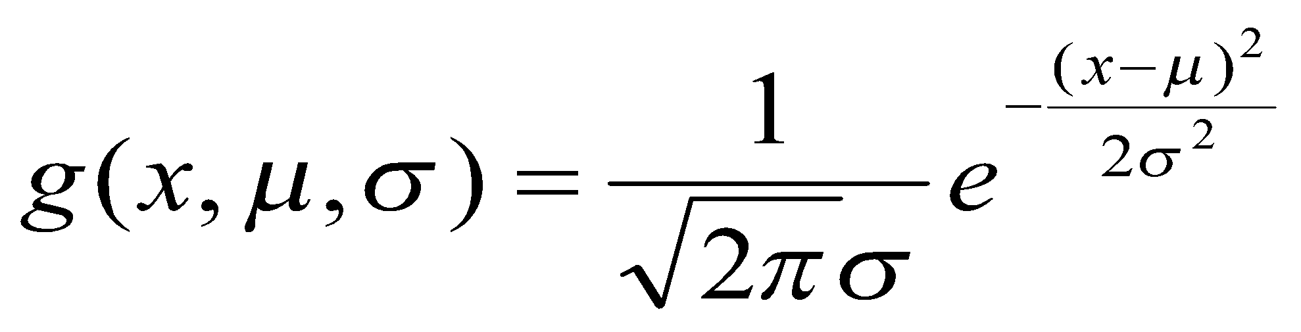
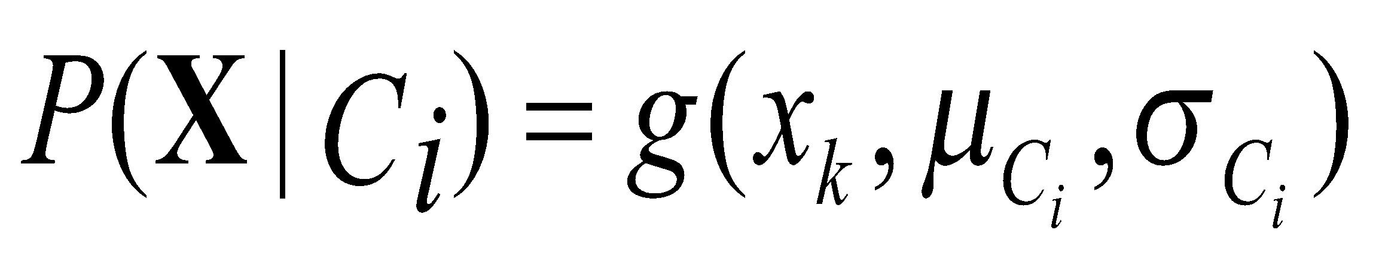
Naïve Bayes Classifier
A simplified assumption: attributes are conditionally independent (i.e., no dependence relation between attributes):
This greatly reduces the computation cost: Only counts the class distribution
If A_{k} is categorical, P(x_{k}|C_{i}) is the # of tuples in C_{i} having value x_{k} for A_{k} divided by |C_{i, D}| (# of tuples of C_{i} in D)
If A_{k} is continous-valued, P(x_{k}|C_{i}) is usually computed based on Gaussian distribution with a mean μ and standard deviation σ
and P(x_{k}|C_{i}) is
42
Notes:
42

Slide 43
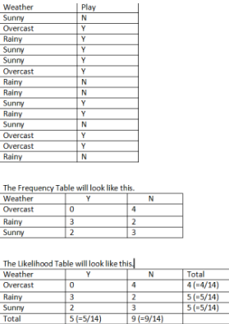
Simple Inference
Consider the following data. Depending on the
weather (sunny, rainy or overcast),
the children will play(Y) or not play(N).
Here, the total number of observations = 14
Probability that children will play given that weather is sunny :
P( Yes| Sunny) = P(Sunny | Yes) * P(Yes) / P(Sunny)
= 0.33 * 0.64 / 0.36
= 0.59

Slide 44
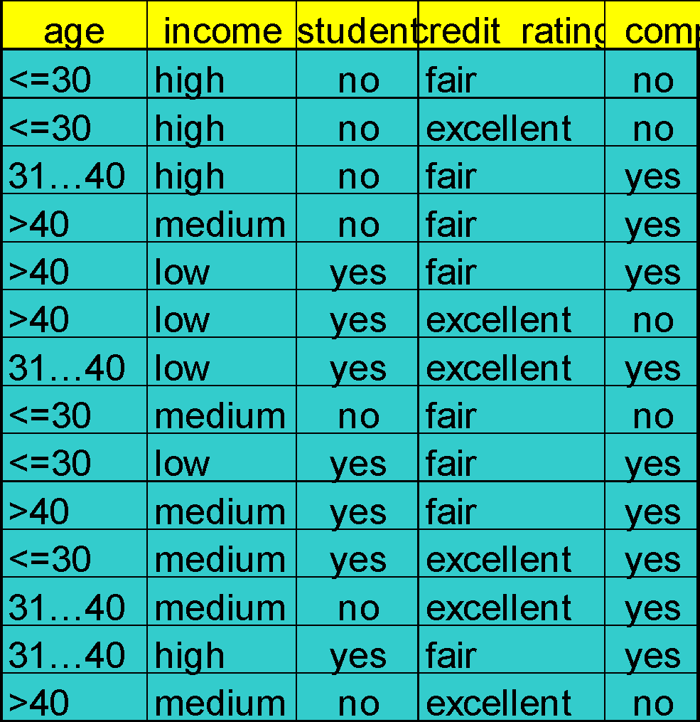
Naïve Bayes Classifier: Training Dataset
Class:
C1:buys_computer = ‘yes’
C2:buys_computer = ‘no’
Data to be classified:
X = (age <=30,
Income = medium,
Student = yes
Credit_rating = Fair)
44
Notes:
44

Slide 45
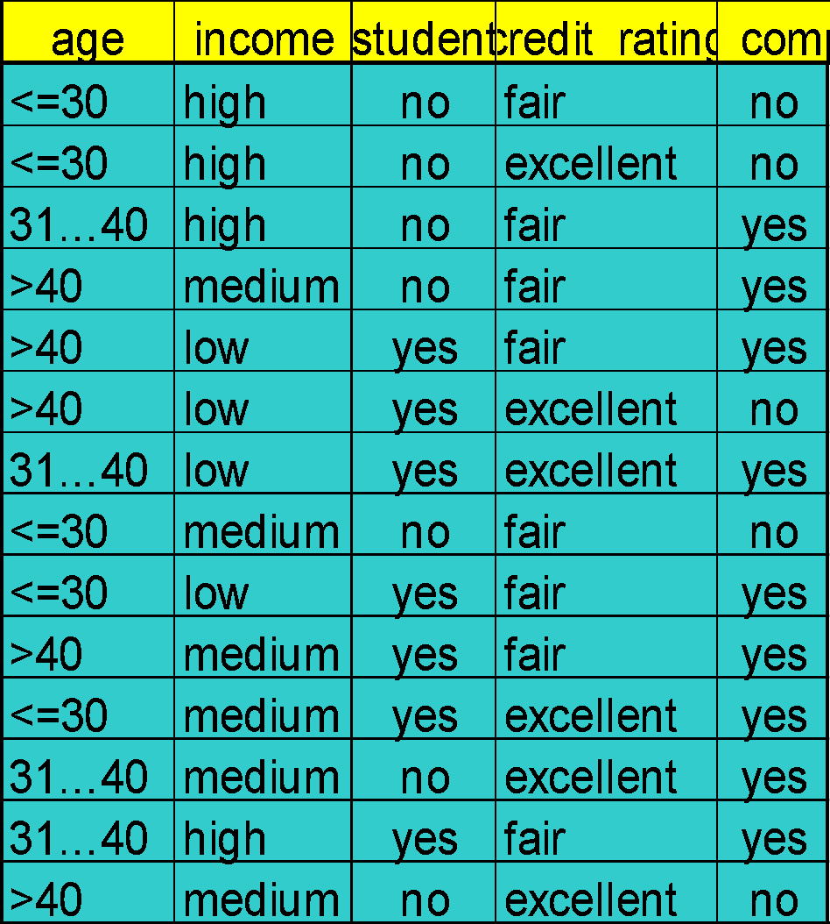
Naïve Bayes Classifier: An Example
P(C_{i}): P(buys_computer = “yes”) = 9/14 = 0.643
P(buys_computer = “no”) = 5/14= 0.357
Compute P(X|C_{i}) for each class
P(age = “<=30” | buys_computer = “yes”) = 2/9 = 0.222
P(age = “<= 30” | buys_computer = “no”) = 3/5 = 0.6
P(income = “medium” | buys_computer = “yes”) = 4/9 = 0.444
P(income = “medium” | buys_computer = “no”) = 2/5 = 0.4
P(student = “yes” | buys_computer = “yes) = 6/9 = 0.667
P(student = “yes” | buys_computer = “no”) = 1/5 = 0.2
P(credit_rating = “fair” | buys_computer = “yes”) = 6/9 = 0.667
P(credit_rating = “fair” | buys_computer = “no”) = 2/5 = 0.4
X = (age <= 30 , income = medium, student = yes, credit_rating = fair)
P(X|C_{i}) : P(X|buys_computer = “yes”) = 0.222 x 0.444 x 0.667 x 0.667 = 0.044
P(X|buys_computer = “no”) = 0.6 x 0.4 x 0.2 x 0.4 = 0.019
P(X|C_{i})*P(C_{i}) : P(X|buys_computer = “yes”) * P(buys_computer = “yes”) = 0.028
P(X|buys_computer = “no”) * P(buys_computer = “no”) = 0.007
Therefore, X belongs to class (“buys_computer = yes”)
45
Notes:
45

Slide 46
Naïve Bayes Classifier: Comments
Advantages
Easy to implement
Good results obtained in most of the cases
Disadvantages
Assumption: class conditional independence, therefore loss of accuracy
Practically, dependencies exist among variables
E.g., hospitals: patients: Profile: age, family history, etc.
Symptoms: fever, cough etc., Disease: lung cancer, diabetes, etc.
Dependencies among these cannot be modeled by Naïve Bayes Classifier
How to deal with these dependencies? Bayesian Belief Networks
46
Notes:
46

Slide 47
BAYESIAN BELIEF NETWORK
In Naïve Bayes Classifier we make the assumption of class conditional independence, that is given the class label of a sample, the value of the attributes are conditionally independent of one another.
However, there can be dependences between value of attributes. To avoid this we use Bayesian Belief Network which provide joint conditional probability distribution.
A Bayesian network is a form of probabilistic graphical model. Specifically, a Bayesian network is a directed acyclic graph of nodes representing variables and arcs representing dependence relations among the variables.

Slide 48
Bayesian Belief Networks
Bayesian belief networks (also known as Bayesian networks, probabilistic networks): allow class conditional independencies between subsets of variables
A (directed acyclic) graphical model of causal relationships
Represents dependency among the variables
Gives a specification of joint probability distribution
Nodes: random variables
Links: dependency
X and Y are the parents of Z, and Y is the parent of P
No dependency between Z and P
Has no loops/cycles
X
Y
Z
P
48
Notes:
48

Slide 49
BAYESIAN BELIEF NETWORK
A Bayesian network is a representation of the joint distribution over all the variables represented by nodes in the graph. Let the variables be X(1), ..., X(n).
Let parents(A) be the parents of the node A. Then the joint distribution for X(1) through X(n) is represented as the product of the probability distributions P(Xi|Parents(Xi)) for i = 1 to n. If X has no parents, its probability distribution is said to be unconditional, otherwise it is conditional.

Slide 50
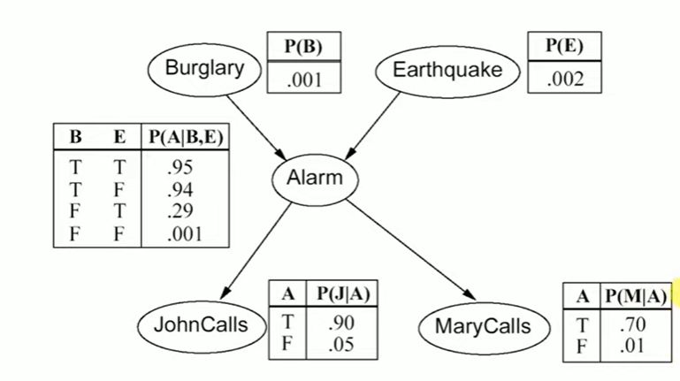
0.01
Notes:
https://www.youtube.com/watch?v=hEZjPZ-Ze0A&list=RDLVhEZjPZ-Ze0A&index=1

Slide 51
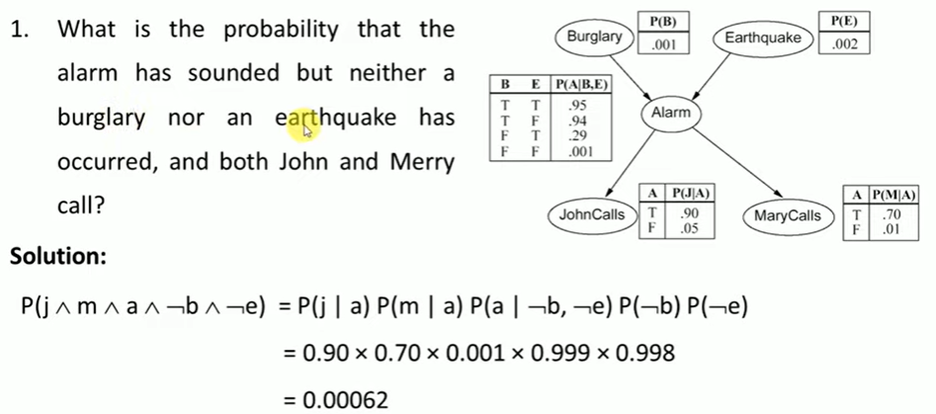
Probability of j depends on a so p(j/a)
Probability of m depends on a so p(m/a)
Probability of a depends on b and e but in problem it is not b , not e so p(a|not b, not e)
In b and e independent event so p(b) in problem it is p(not b) same for e
Notes:
https://www.youtube.com/watch?v=hEZjPZ-Ze0A&list=RDLVhEZjPZ-Ze0A&index=1

Slide 52
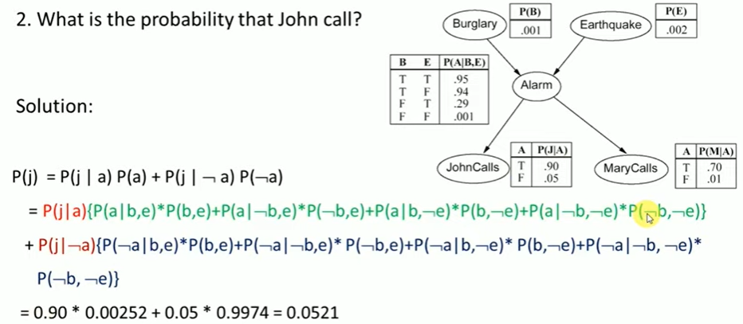
Marginal probability : probability of single variable
52
Notes:
https://www.youtube.com/watch?v=hEZjPZ-Ze0A&list=RDLVhEZjPZ-Ze0A&index=1
52

Slide 53
Training Bayesian Networks: Several Scenarios
Scenario 1: Given both the network structure and all variables observable: compute only the CPT entries
Scenario 2: Network structure known, some variables hidden: gradient descent (greedy hill-climbing) method, i.e., search for a solution along the steepest descent of a criterion function
Weights are initialized to random probability values
At each iteration, it moves towards what appears to be the best solution at the moment, w.o. backtracking
Weights are updated at each iteration & converge to local optimum
Scenario 3: Network structure unknown, all variables observable: search through the model space to reconstruct network topology
Scenario 4: Unknown structure, all hidden variables: No good algorithms known for this purpose
53
Notes:
53

Slide 54
Summary
Probability is a rigorous formalism for uncertain knowledge.
Joint probability distribution specifies probability of every atomic event.
Queries can be answered by summing over atomic events.
For nontrivial domains, we must find a way to reduce the joint size.
Independence, conditional independence and Bayes’ rule provide the tools.
Notes:
54

